Slide 1
Data Frames in R
Mr. Shrikrishna Anand Narvekar
Assitant Professor
Computer Engineering department
Agnel Institute of Technology and Design

Slide 2
Content
What is a data frame?
Construct a data frame
Access data frame columns
Missing values in the dataframes

Slide 3
What is Data Frame?
A data frame is a two-dimensional data structure which can store data in tabular format.
Data frames have rows and columns and each column can be a different vector. And different vectors can be of different data types.
Data frames are usually created by calling read.table or read.csv
You can construct a data frame using data.frame() function

Slide 4
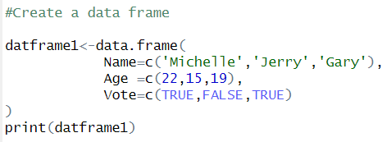
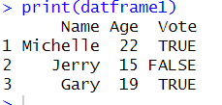
Construct a data frame
Code
Output
Here, Name, Age and Vote are column names of vector of string, numeric and Boolean type respectively

Slide 5


Access data frame columns
Here, dataframe[1] returns the first column but retains the data frame structure
Dataframe[[“Name”]] returns actual data with name column as vector. It does not retain the data frame structure but instead gives you a simpler data structure (a vector).
You can very using class() function

Slide 6
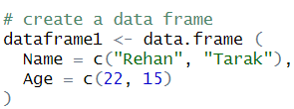

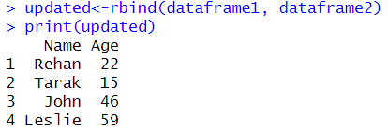
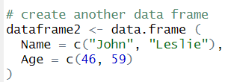

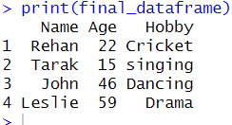
Exercise
Combine dataframes using rbind and cbind function
Using R bind combine data frames
Code
Output
Code
Output

Slide 7
Working with Employee details dataset
We have a dataset named Employee details.csv which gives us details about employees as shown below
Column Descriptions:
Id: Unique identifier for each employee
Name: Name of the Employee
Gender: Gender of the employee
Salary: Salary earned by each employee
Department :The department where employees work
Age: Age of the employee
Joining date: The date on which employees has joined the organization
Performance score: Numerical score representing performance of the employee

Slide 8
Getting Data into and out of the R
Reading data into R
read.table (): Read tabular data from a file
read.csv (): it reads csv file
readLines(): Reads text file content line-by-line into a character vector.
source(): Executes R code from a file, effectively running scripts.
dget(): Reads an R object from a file, restoring it from its textual representation.
load(): Loads saved R workspaces from a file, restoring all

Slide 9
Write data to files
write.table() : for writing tabular data to text files (i.e. CSV) or connections
writeLines() : for writing character data line-by-line to a file or connection • dump() : for dumping a textual representation of multiple R objects
dput() : for outputting a textual representation of an R object
save() :for saving an arbitrary number of R objects in binary format (possiblycompressed) to a file.
Serialize() :for converting an R object into a binary format for outputting to a connection (orfile).

Slide 10
Missing values in the dataframes
Missing values are absent for specific variable in dataset
They are can be represented by various ways such as blank cells, symbols like NA
In many programming languages and data analysis tools, NA is used as a placeholder for missing values, allowing for proper handling during data processing.
In the context of data preprocessing, "NA" and "NAN" are used to represent missing values:
NA: Not Available
NAN: Not a Number

Slide 11
Handling missing values
During data preprocessing, handling these missing values appropriately is crucial for accurate analysis and modeling.
Common techniques include:
Imputation: Filling missing values with mean, median mode etc
Removal: delete rows which contains Null Values
Using Algorithms: Use appropriate ML algorithms which can handle missing values
NA Values have class also, so there are integer NA,character NA

Slide 12
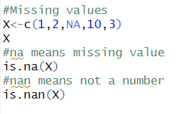
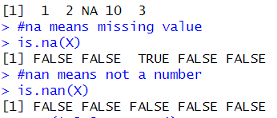
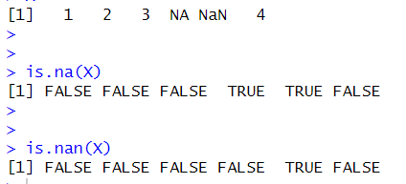
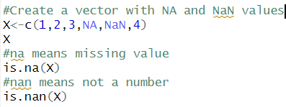
Examples of missing values
CODE
OUTPUT

